Slide 1
Capstone Project Sql

Slide 2
agenda
Introduction
Data Analysis
Data Wrangling
Future Engineering
Exploratory Data Analysis(EDA)
Conclusion

Slide 3

Amazon Sales Data

Slide 4
Introduction
The major aim of this project is to gain insight into the sales data of Amazon to understand the different factors that affect sales of the different branches.
Data Analysis Types:
Product Analysis
Sales Analysis
Customer Analysis
Approaches used:
Data wrangling
Feature Engineering
Exploratory data Analysis

Slide 5
Data Analysis
Data: Amazon Sales data
Branches :3
Country: Myanmar
Locations:Mandalay, yangon,Naypyitaw
Table columns:17
Table Rows:1000

Slide 6
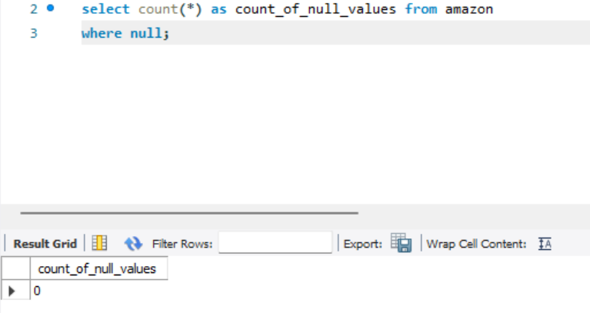
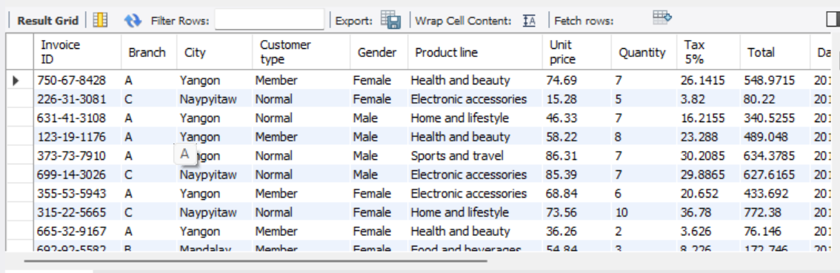
Data Wrangling:
1.Build a database
2. Create a table and insert the data.
3. Select columns with null values in them.

Slide 7
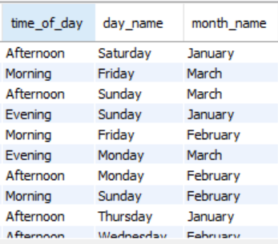
Feature Engineering
Add a new column named timeofday to give insight of sales in the Morning, Afternoon and Evening. This will help answer the question on which part of the day most sales are made.
Add a new column named dayname that contains the extracted days of the week on which the given transaction took place (Mon, Tue, Wed, Thur, Fri). This will help answer the question on which week of the day each branch is busiest.
Add a new column named monthname that contains the extracted months of the year on which the given transaction took place (Jan, Feb, Mar). Help determine which month of the year has the most sales and profit.

Slide 8


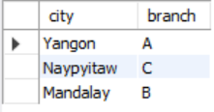
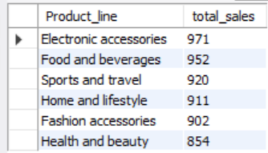
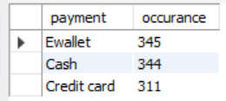
Exploratory data analysis(EDA)
What is the count of distinct cities in the dataset?
For each branch, what is the corresponding city?
What is the count of distinct product lines in the dataset?
Which payment method occurs most frequently?
Which product line has the highest sales?

Slide 9
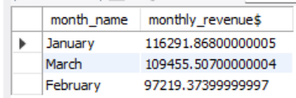
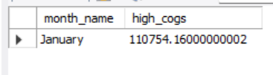



Exploratory data analysis(EDA)
6.How much revenue is generated each month?
7.In which month did the cost of goods sold reach its peak?
8.Which product line generated the highest revenue?
9.In which city was the highest revenue recorded?
10.Which product line incurred the highest Value Added Tax?

Slide 10
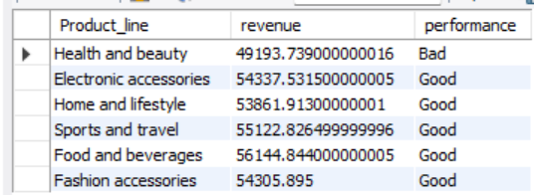
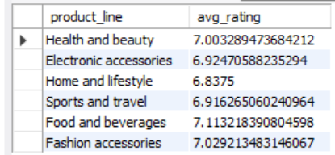
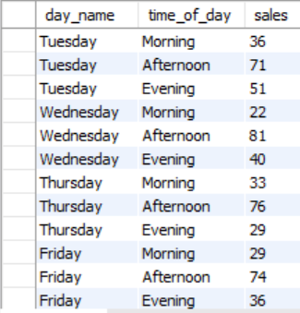
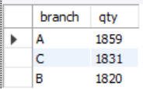

Exploratory data analysis(EDA)
For each product line, add a column indicating "Good" if its sales are above average, otherwise "Bad."
Identify the branch that exceeded the average number of products sold.
Which product line is most frequently associated with each gender?
Calculate the average rating for each product line.
Count the sales occurrences for each time of day on every weekday.

Slide 11





Exploratory data analysis(EDA)
Identify the customer type contributing the highest revenue.
Determine the city with the highest VAT percentage.
Identify the customer type with the highest VAT payments.
What is the count of distinct customer types in the dataset?
What is the count of distinct payment methods in the dataset?

Slide 12



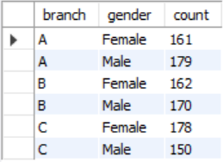
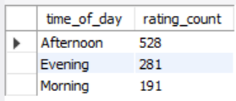
Exploratory data analysis(EDA)
Which customer type occurs most frequently?
Identify the customer type with the highest purchase frequency.
Determine the predominant gender among customers.
Examine the distribution of genders within each branch.
Identify the time of day when customers provide the most ratings.

Slide 13
Sql Script : Amazon_Data(SQL Project).sql

Slide 14
Thank you
Sandhya Rao
mfivesandy@gmail.com

